Slide 1
Student-Teacher Booking Appointment
A Web-Based Scheduling Platform

Slide 2
Problem Statement
🔹 Traditional appointment booking systems require students to visit the faculty in person, leading to time wastage, scheduling conflicts, and inefficiency. 🔹 There is no centralized system for students to view available teachers and book an appointment instantly. 🔹 Communication gaps arise when students cannot confirm, modify, or cancel appointments.
Solution:
We propose a web-based appointment booking system that allows:
Students to book and manage appointments online.
Teachers to approve, reject, and manage schedules efficiently.
Admins to oversee registrations and maintain system integrity.

Slide 3
Project Objectives
✔ Reduce waiting times by allowing students to book appointments online. ✔ Enhance efficiency in managing student-teacher meetings. ✔ Enable real-time communication via messages and notifications. ✔ Store appointment details securely using Firebase. ✔ Ensure mobile and web accessibility for all users.

Slide 4
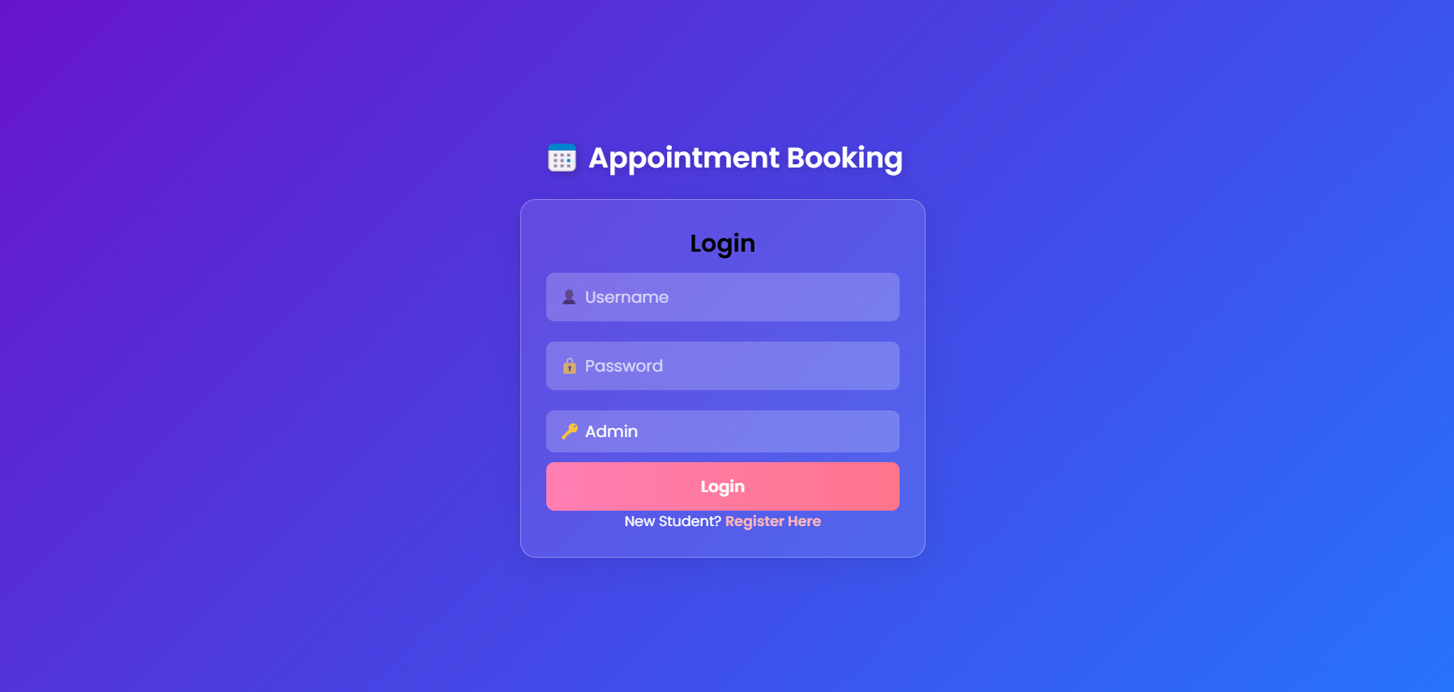
Home Page:

Slide 5
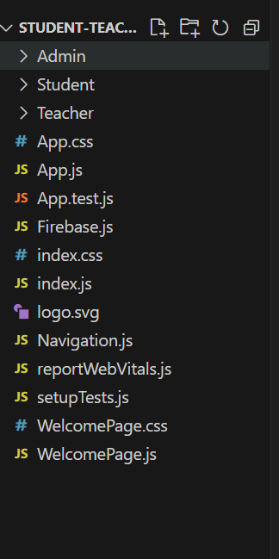
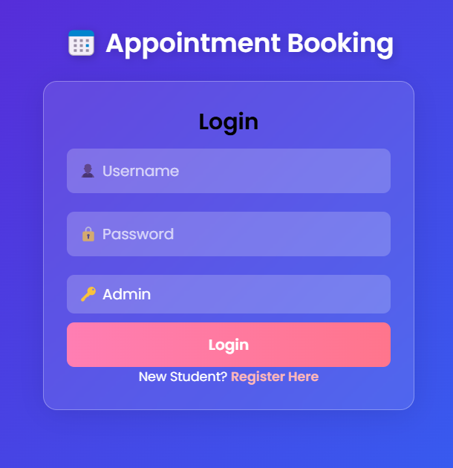
System Features:
Project File Structure:

Slide 6
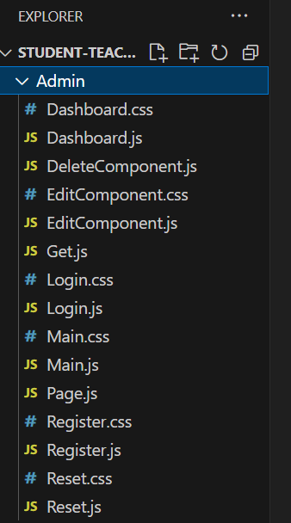
Admin Features
✔ Add, update, and delete teachers. ✔ Approve or reject student registrations. ✔ Manage the database of appointments and users.

Slide 7
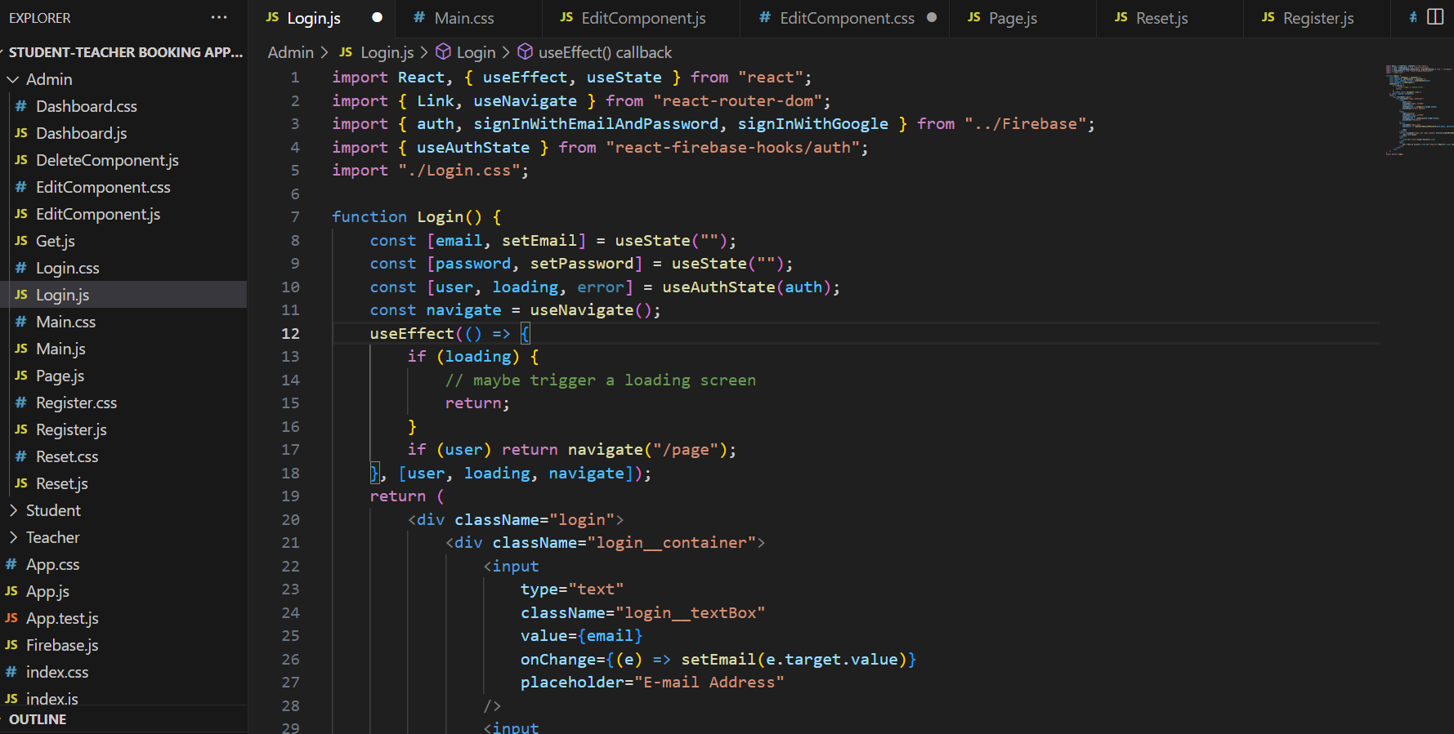

Slide 8
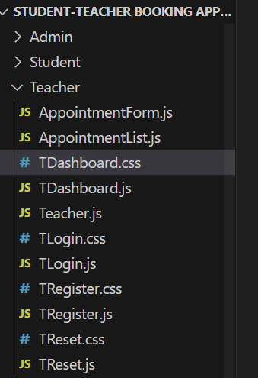
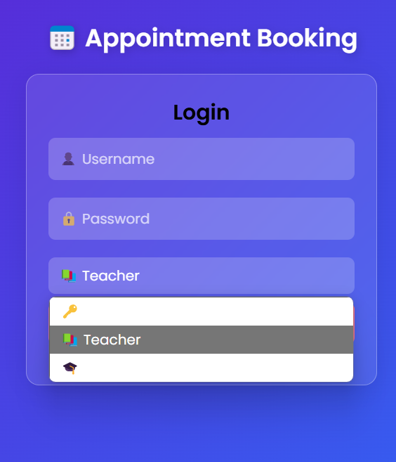
Teacher Features
✔ Login securely using Firebase authentication. ✔ Schedule, approve, or cancel appointments. ✔ View all upcoming appointments. ✔ View and respond to student messages. ✔ Logout securely.

Slide 9
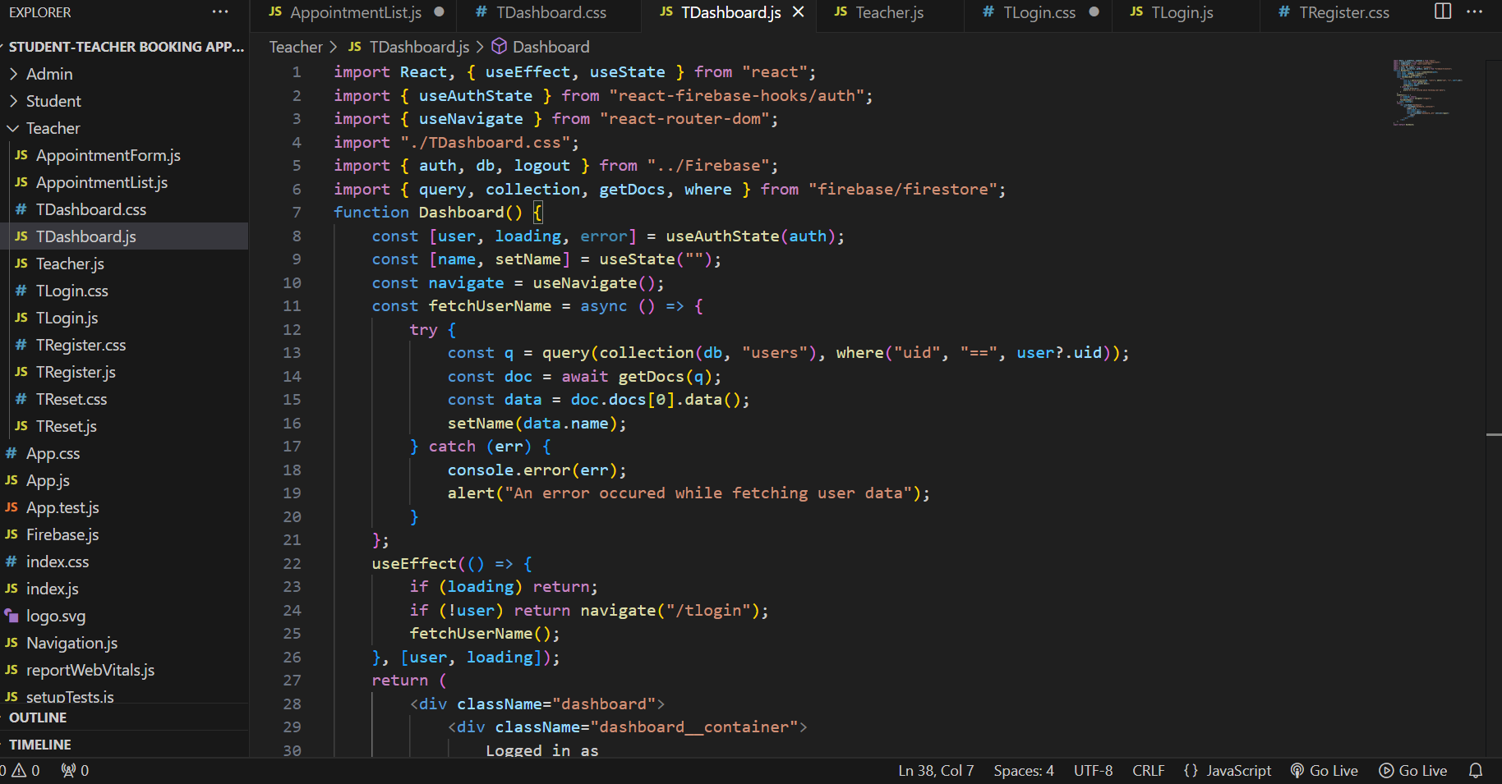

Slide 10
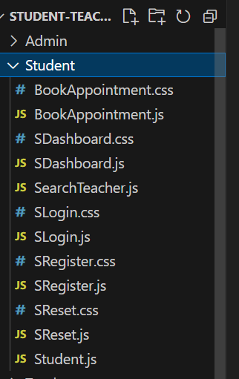
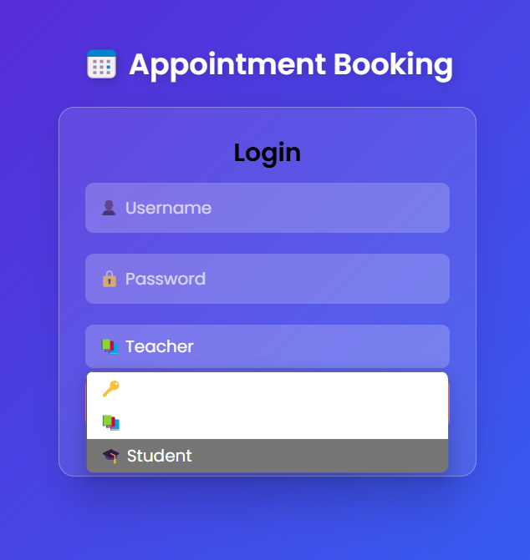
Student Features
✔ Register and log in securely. ✔ Search for teachers based on department or subject. ✔ Book appointments online. ✔ Send messages to teachers.

Slide 11
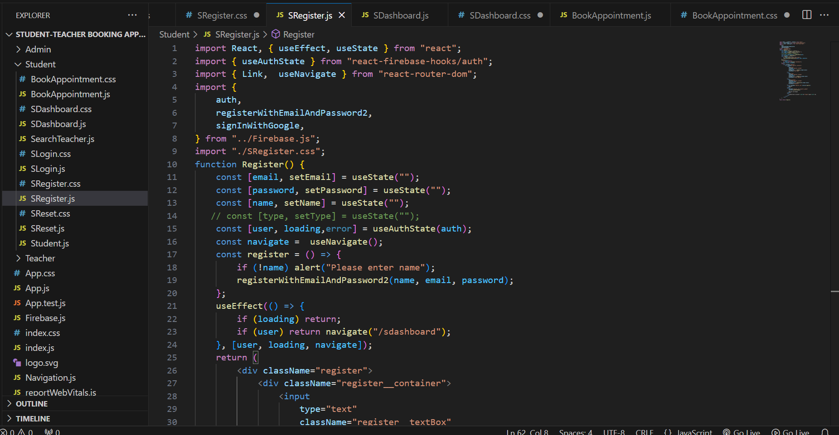

Slide 12
System Architecture
How the system works:
1️⃣ Student searches for teachers and selects an available slot. 2️⃣ Teacher approves/rejects the request in real time. 3️⃣ Admin manages registrations and ensures smooth workflow. 4️⃣ Firebase stores all data securely and updates it dynamically.
🔹 Include a System Architecture Diagram showing:
Users (Student, Teacher, Admin)
Frontend (HTML, CSS, JavaScript)
Backend (Firebase for database & authentication)

Slide 13
Conclusion
🎯 Final Takeaways ✅ The Student-Teacher Appointment Booking System improves efficiency in scheduling meetings. ✅ The system is user-friendly, scalable, and secure with Firebase authentication. ✅ It can be expanded with new features like AI-based appointment recommendations.

